Slide 1
Introduction
Who am i?
Notes:
Good morning/ afternoon
My name is Avi Nissim – Hart and I am a trainee IT Consultant from London working at QA consulting.

Slide 2
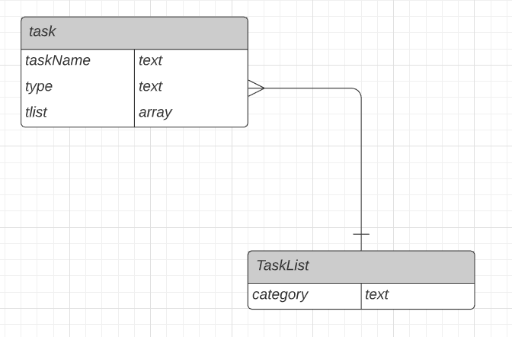
My approach
Product Specification
A task / reminder project
Notes:
Upon receiving the product specification, I decided to make a reminder / to do list
I started planning out in my head how I wanted to go about doing this project.
Despite this, my plans changed as I learnt more about javascript as I found alternative ways to implement features for CRUD functionality
For this project, I already knew from the beginning how I would implement my database as I would only need 2. Tasks and the task list which would be categorised as shopping for example. The list id would be within the task table as a foreign key.
I started out by making a risk assessment and making some user stories based on the specification to a new project sprint board on my Jira. I also designed an ERD for how I thought my tables would connect. As you can see here

Slide 3
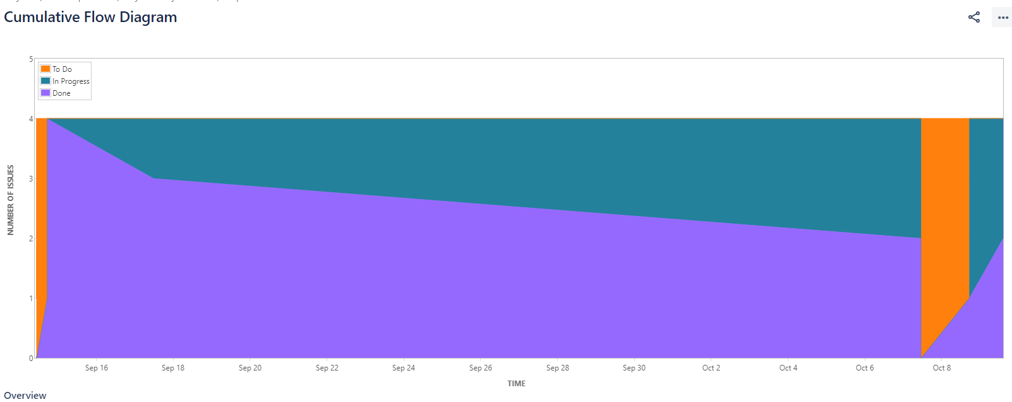
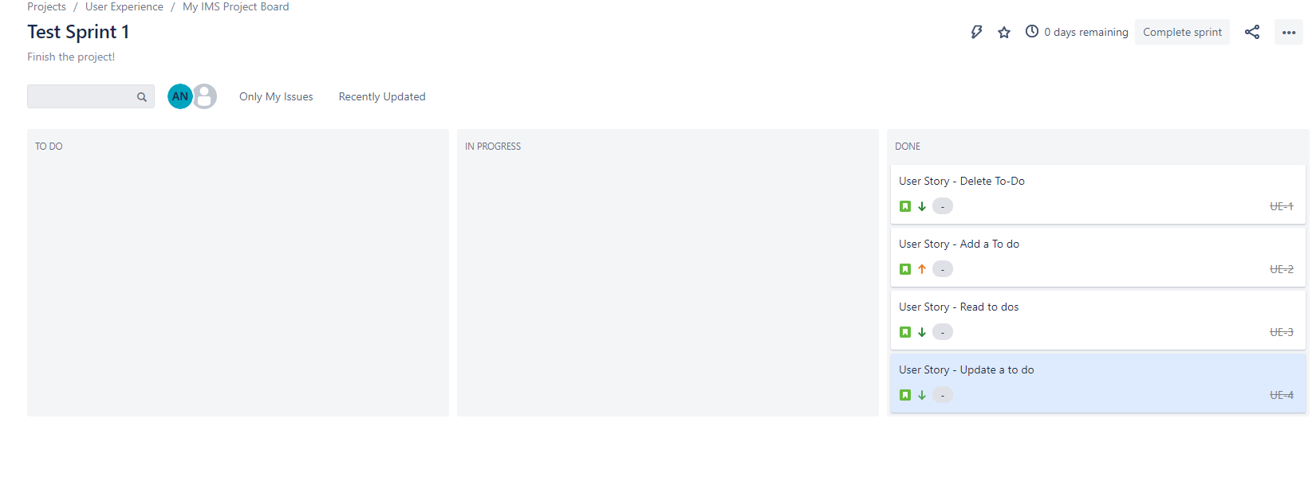
Sprint Plan
What was completed and what was left behind?
Notes:
As you can see above, I have a couple of screenshots from my sprint. I successfully implemented all the features desired for the project. That being said, I found myself going back and forth a lot for the front end and realised that things kept going wrong which caused a major delay. In addition to this, I unfortunately had an issue with jira where I had to remake my board so there may be some discrepencies.
I hoped to achieve full crud functionality of creating, reading, updating and deleting both tasks and the lists that contain them. This all worked out as intended, barring 2 slight testing issues at the very end which merely came from a service integration update test issue which I decided to comment out in order to appropriately package, and the very last selenium test for deleting a list. Although its functionality works, there was an unknown issue with identifying the object required to perform the task.
Overall, I am pleased with the result of my extensive testing.

Slide 4
My Journey
What technologies have I learned for this project?
- Java (in spring)
- JavaScript/HTML
- Maven
- Junit Testing
- Selinium Testing
-Mockito Testing
Notes:
From the beginning of my training, I have been taught a variety of technologies, principles, and concepts which have all prepared me to complete this project.
We spent a lot of time for this project, learning a lot of web development (html and javascript). Which we could apply our existing knowledge from the previous project to make work with our back end.
So I was able to use my crud functionality set up in my Spring and have it implemented through my front end website.
In addition to this, we learnt more about testing including Mockito and selinium. Therefore, for this project I have done rigorous backend testing with integration and unit testing utilising Mockito. And I also used selenium for front end testing.
All other technologies used that were previously used have merely been utilised with a more in depth approach. This time I was more focussed on how I used my feature branch and the times I would commit and merge.

Slide 5
CI
How did I set up my Continuous Integration Pipeline?
- Regular Commits and Pushes to Feature Branch
- Merging to dev branch when satisfied
- Repository: https://github.com/AviNissimHart/ToDoList
Notes:
Compared to last time, I did much better with committing regularly to the appropriate branches and merging at the right time.
Using the feature branch for each feature, I would push to feature when finished. Merge to dev branch when satisfied and then pulling to keep up to date locally.
This repeated itself throughout the implementation until the very end where I merged into my master branch when satisfied with final product. I did all this by going through my jira sprint board and tackling one task at a time for each commit and then testing on top of it all with each group of tests as separate commits.

Slide 6
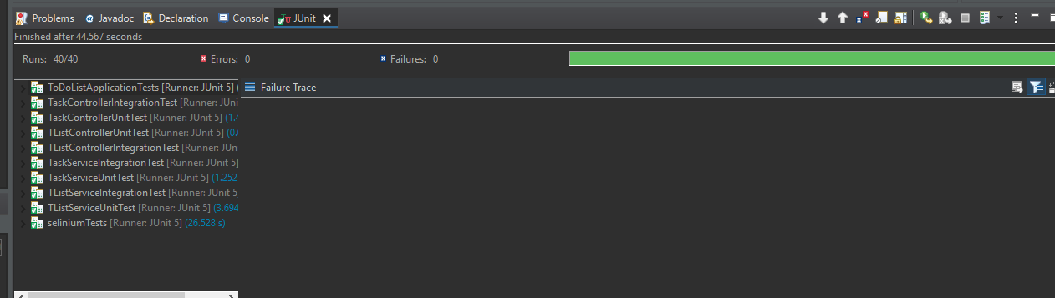
Testing
- Coverage
- Static analysis
- Red-green-refactor
Notes:
When it came to my testing, I managed to get everything working perfectly up until the last part of selenium and the previously discussed update method of one of the service integration test. I commented these out to ensure I could package appropriately.
Unfortunaltyl due to time constraints I could not get my test coverage to show, nor the red green refactoring. This upset me deeply as I was working on this until the veery last minute trying to resolve within spring.

Slide 7
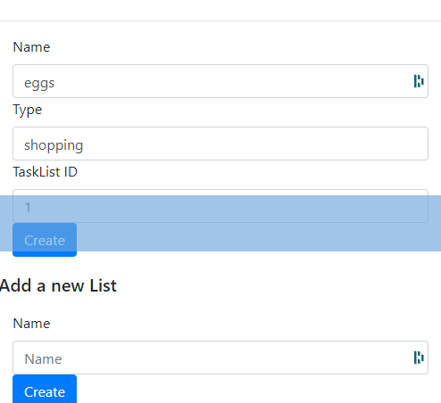
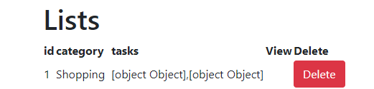
Demonstration
A couple of user stories e.g. create task and create list
Notes:
As you can see for 1st I created a task list for shopping and a task for eggs

Slide 8
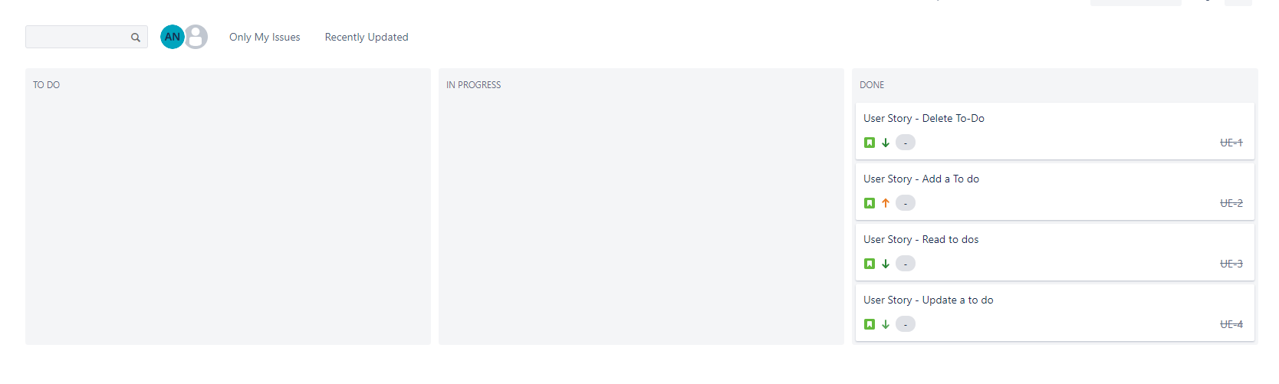
My Project Management Board
Notes:
Here is a better View of my Project Management Board with my sprint of all the features I had to implement. This was taken near the end as I had to revise some of the features to fix them.
Overall, I completed everything needed, I was just a little late in doing so and I feel I could have done a bit better with the presentation

Slide 9
Sprint Retrospective
What went well and what can be improved?
- Database preparation
- Testing
- Successful implementation of most of the features
Notes:
In retrospect, I am very pleased with the progress I made with the majority of the project.
I feel that I learnt a lot by doing all this and I now have a better understanding of what I would do differently next time.
To improve, I must focus more on the way in which I structure my testing .

Slide 10
Conclusion
- Reflections on project
- Future steps
Notes:
Overall, I am very proud of my second project and how I managed to make the majority of it work as intended. I feel that I have learnt a lot from my mistakes – from which I will be sure to tackle future projects better by ensuring that the areas I realise require correction are adhered to.
I feel that completing this project is a major milestone in my journey in programming and it has changed the way in which I now perceive a large project which requires more extensive testing of front and back end.
In the future, I will be sure to spread my time more accordingly to the required features.

Slide 11
Questions
Any questions?
Notes:
Thank you very much for listening, does anybody have any questions?

